Slide 1

Object Oriented Programming Presentation
Group Members
Chevannese Ellis – 2301109
Kehvoi Thompson– 2304224
Janae Bernard- 2209025
Karlicia Sutherland – 2302691
Kay-Ann Green – 2110490

Slide 2
System 1 - Red Plate Licensing (RPLS)
Processing Officer
Driver
System 2 – Ticketing Issuing and Offender Checking System (TIOCS)
JCF Officer
Driver

Slide 3

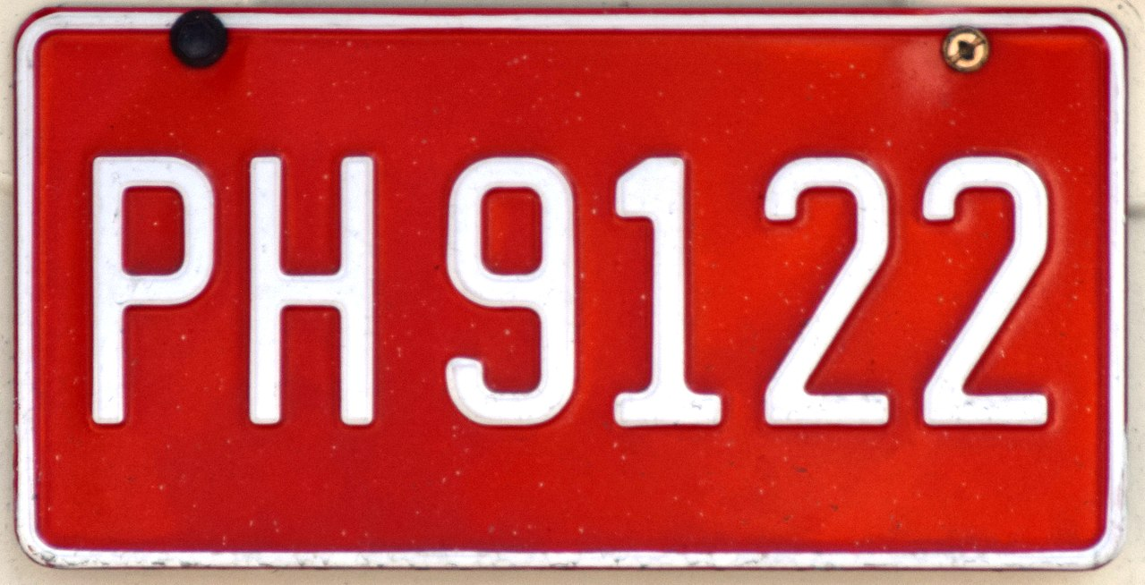
01
Processing Officer

Slide 4
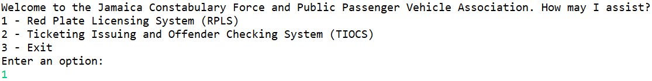
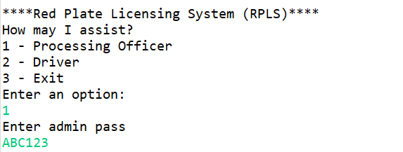
How to access Processing Officer

Slide 5
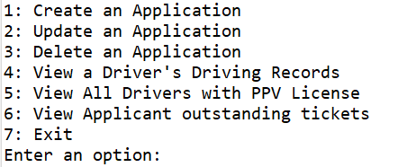
Processing Officer Menu

Slide 6
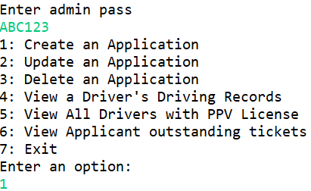
Processing Officer Menu - 1

Slide 7
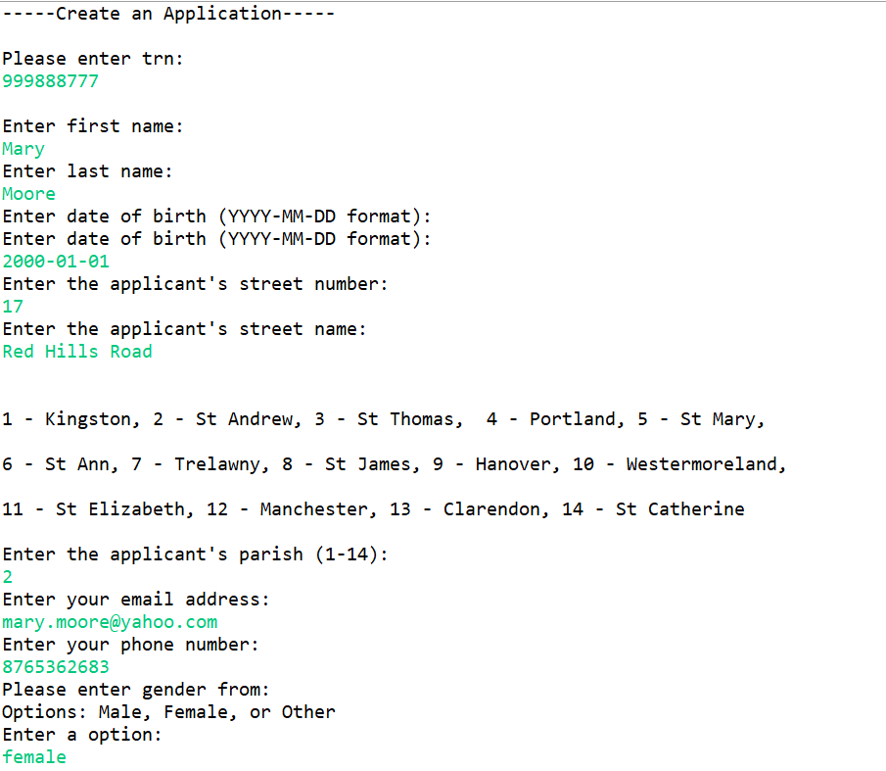
Filling out Personal Details

Slide 8
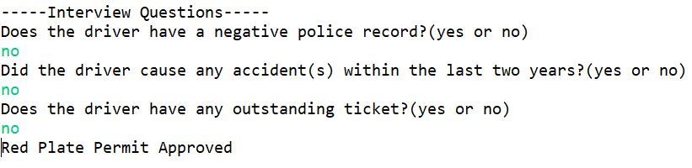
Interview Questions

Slide 9
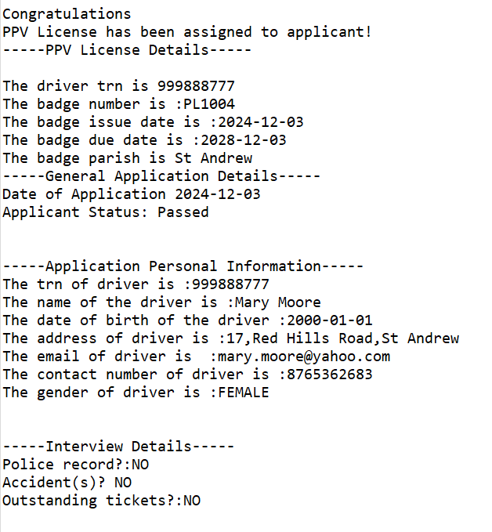
Successful Interview

Slide 10
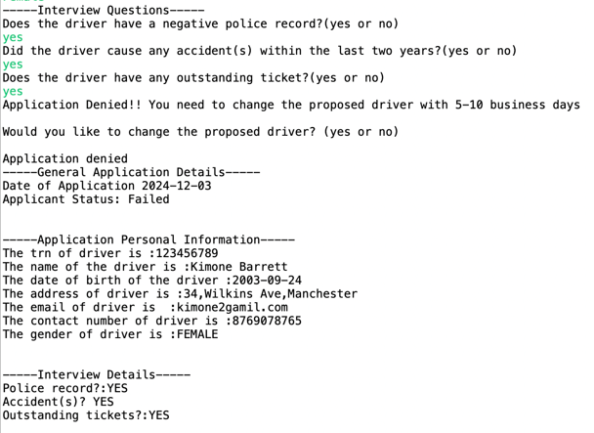
Failed Interview

Slide 11
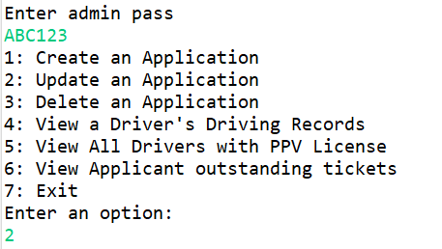
Processing Officer Menu - 2

Slide 12
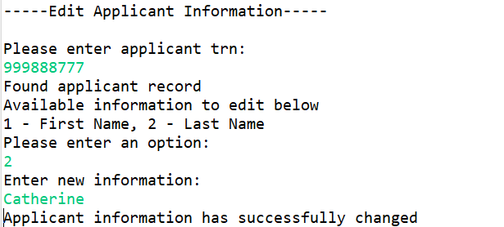
Edit Applicant Information

Slide 13
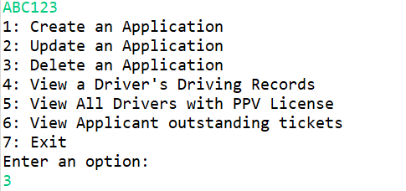
Processing Officer Menu - 3

Slide 14
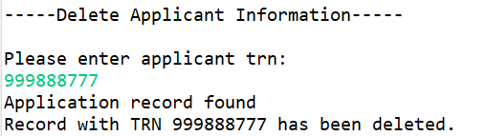
Deleting an Applicant

Slide 15
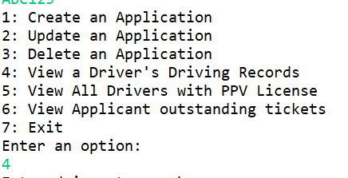
Processing Officer Menu - 4

Slide 16
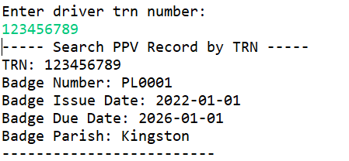
View Driver PPV License

Slide 17
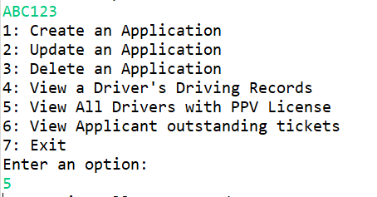
Processing Officer Menu - 5

Slide 18
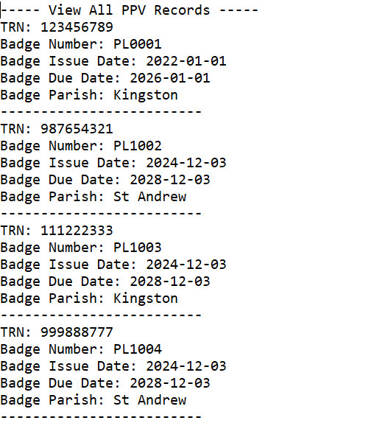
View All Drivers’ PPV License

Slide 19
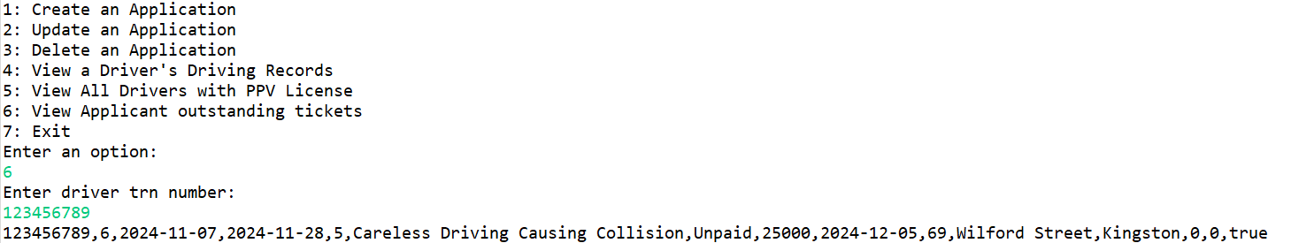
Processing Officer Menu - 6

Slide 20
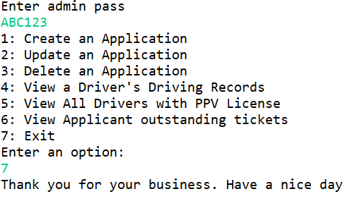
Processing Officer Menu - 7

Slide 21
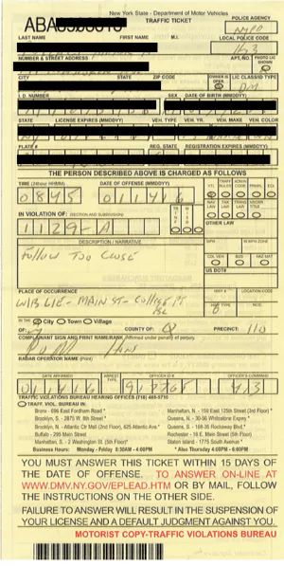
02
JCF Officer

Slide 22
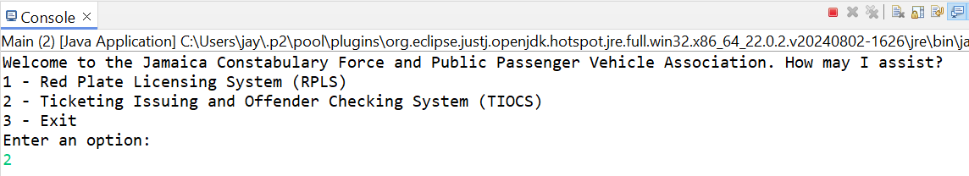
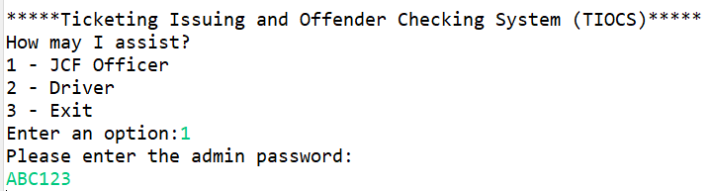
How to access JCF Officer

Slide 23
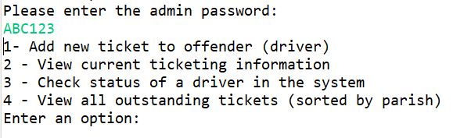
JCF Officer Menu

Slide 24
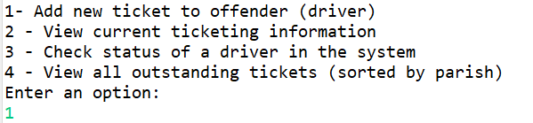
JCF Officer Menu - 1

Slide 25

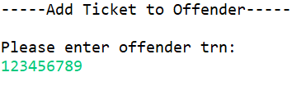
Adding Ticket to Offender

Slide 26
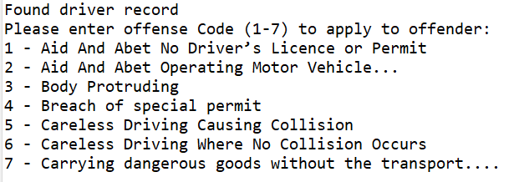
Offense Code

Slide 27
Incorrect Offense Code

Slide 28
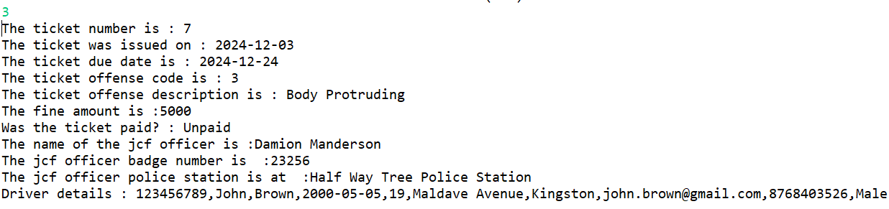
Display of Ticket Information

Slide 29
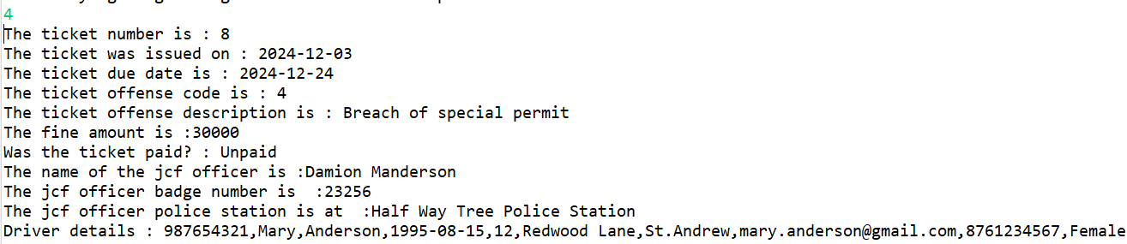
Display of Ticket Information 2

Slide 30
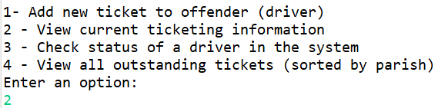
JCF Officer Menu - 2

Slide 31
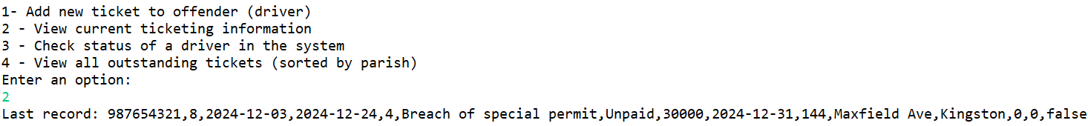
Display of last ticket record

Slide 32
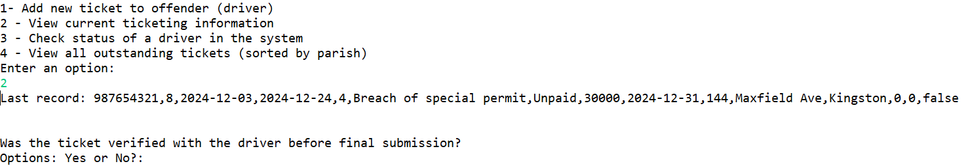
Final Submission Details

Slide 33

Final submission results

Slide 34
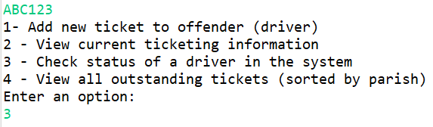
JCF Officer Menu - 3

Slide 35

Check Status of Driver Menu

Slide 36
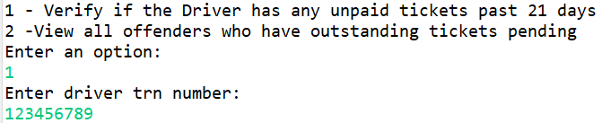
Check Status of Driver Menu

Slide 37
Result

Slide 38

Check Status of Driver Menu

Slide 39
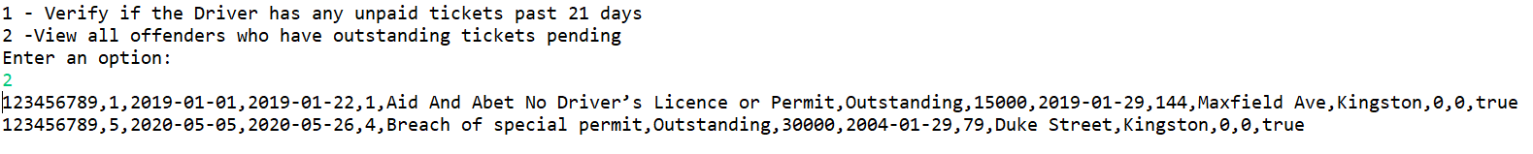
Outstanding Tickets

Slide 40
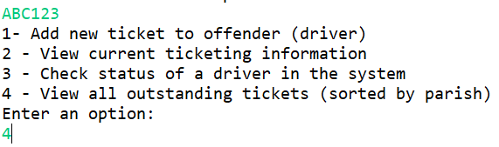
JCF Officer Menu - 4

Slide 41


Slide 42

03
Driver

Slide 43
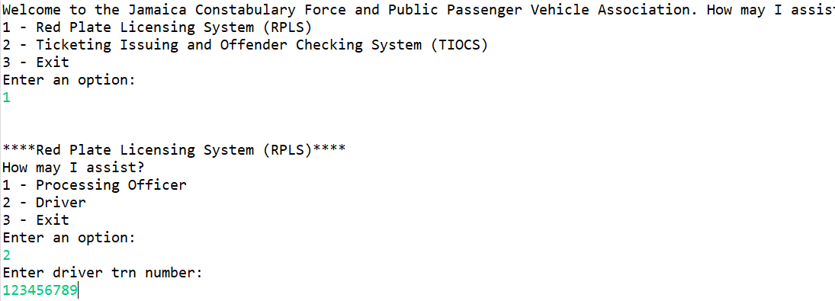
How to access Driver

Slide 44
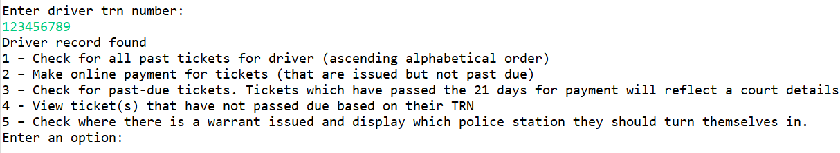
Driver Menu

Slide 45
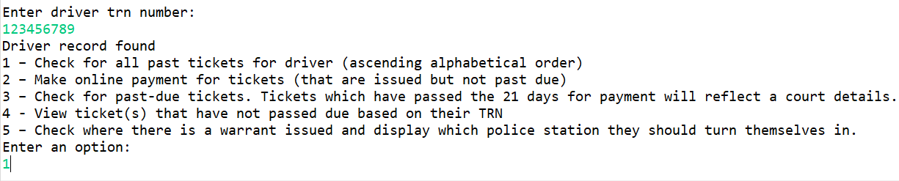
Driver Menu - 1

Slide 46
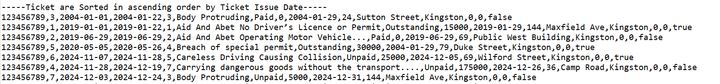
Display

Slide 47
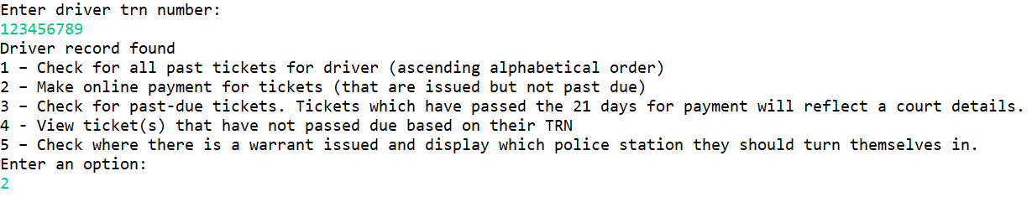
Driver Menu - 2

Slide 48
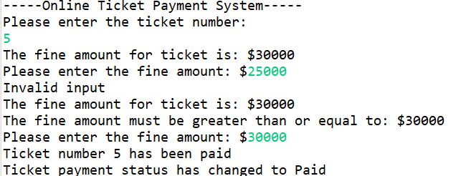
Online Ticket Payment

Slide 49

Paying the Same ticket Number….

Slide 50
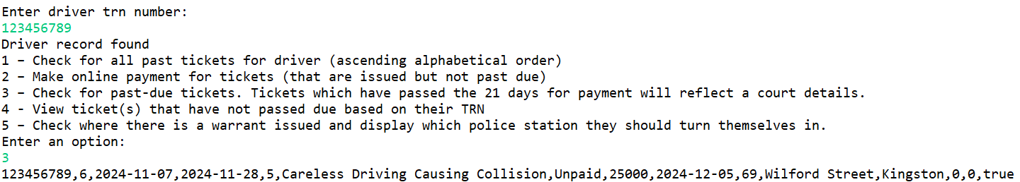
Driver Menu - 3

Slide 51
Check for past due tickets

Slide 52
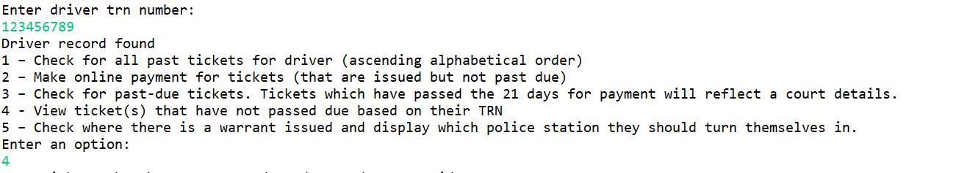
Driver Menu - 4

Slide 53
Not passed due date

Slide 54
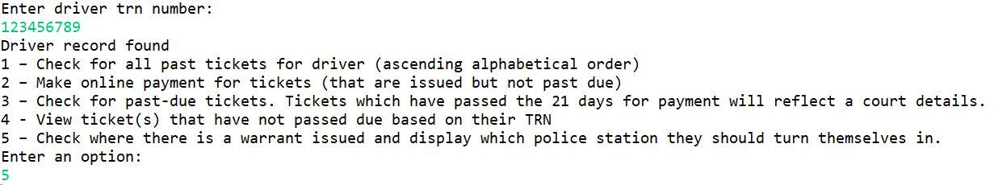
Driver Menu - 5

Slide 55
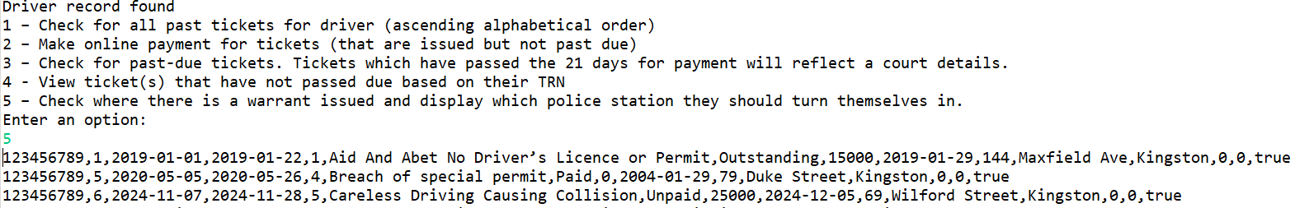
Check for Warrant Display

Slide 56

End of Presentation

